Slide 1
Introduction to SharePoint Hub Sites on Office 365
Jenkins NS
Notes:
This slide is mandatory. Please do not remove.

Slide 2

Jenkins NS
SharePoint & Office 365 Consultant
Cognizant
http://jenkinsblogs.com/
@jenkinsns
Community speaker and blogger. #SPFx #SharePoint #Office365
Based in London, United Kingdom

Slide 3
Notes:
This slide is mandatory. Please do not remove and try to use it during Q&A at the end of your session. Thank you!

Slide 4
WiFi Keys for Attendees
Connect to the wireless network MSFT_GUEST
Login details for the wireless network:
Guest Username O365Sat@outlook.com
Guest Password: 0195

Slide 5
Agenda
Background
Overview
Things you need to know
Demo
Creating a Hub Site
Associate Sites with Hub Sites
SPC18 New announcements
FAQ’s

Slide 6
Where we come from
IT
Lists
HR
Libraries
Pages
Project 1
Project 2
Project 3
Policies
Benefits
Lists
Project 4
Project 5
Libraries
Pages
Site Collection
Sub Sites

Slide 7
Where we are – Modern Experience
Modern Sites are ‘Site Collections’
Always better when they are connected
Companies are made up of smaller groups and teams
Customers want to organize sites into grouping that
Make it easier for users to discover and recall related content
Apply common controls, branding and polices.
Search together and group common news and contents.
No more deep site structures
Modern Site is a “Flat Architecture”
Hubs connect related sites
Sales Report
Site Collections
Yearly Report
News
Sales
Customer Report
Regional sales
Expense Tracker
Feedback
Benefits
Travel Policies
Record Center
HR
Guidance
New Hires

Slide 8
Why do we need SharePoint Hub Sites
A dynamic, ever-changing digital workplace
We want to see things that are relevant
Navigate consistently and easily
Search in the context of where we are
Anyone can post news, comment or like items and read other’s news and comments
Constantly Changing Organisations
As administrators we need quick ways to restructure our sites
We need to be able to provision quickly as new requirements arrive
Customers always looking for a solution immediately.

Slide 9
SharePoint Hub Sites
A solution for dynamically changing site structures
Brings together related Team sites and Communication Sites
Cross-site navigation / Global Navigation
Common look and feel across sites (Theme)
Logo
Rollup News together
Combines site activities
Search across related sites
Admin create Hub Sites and site owners associate/join the hub site.
Sales Report
Yearly Report
Sales
Customer Report
Regional sales
Feedback

Slide 10
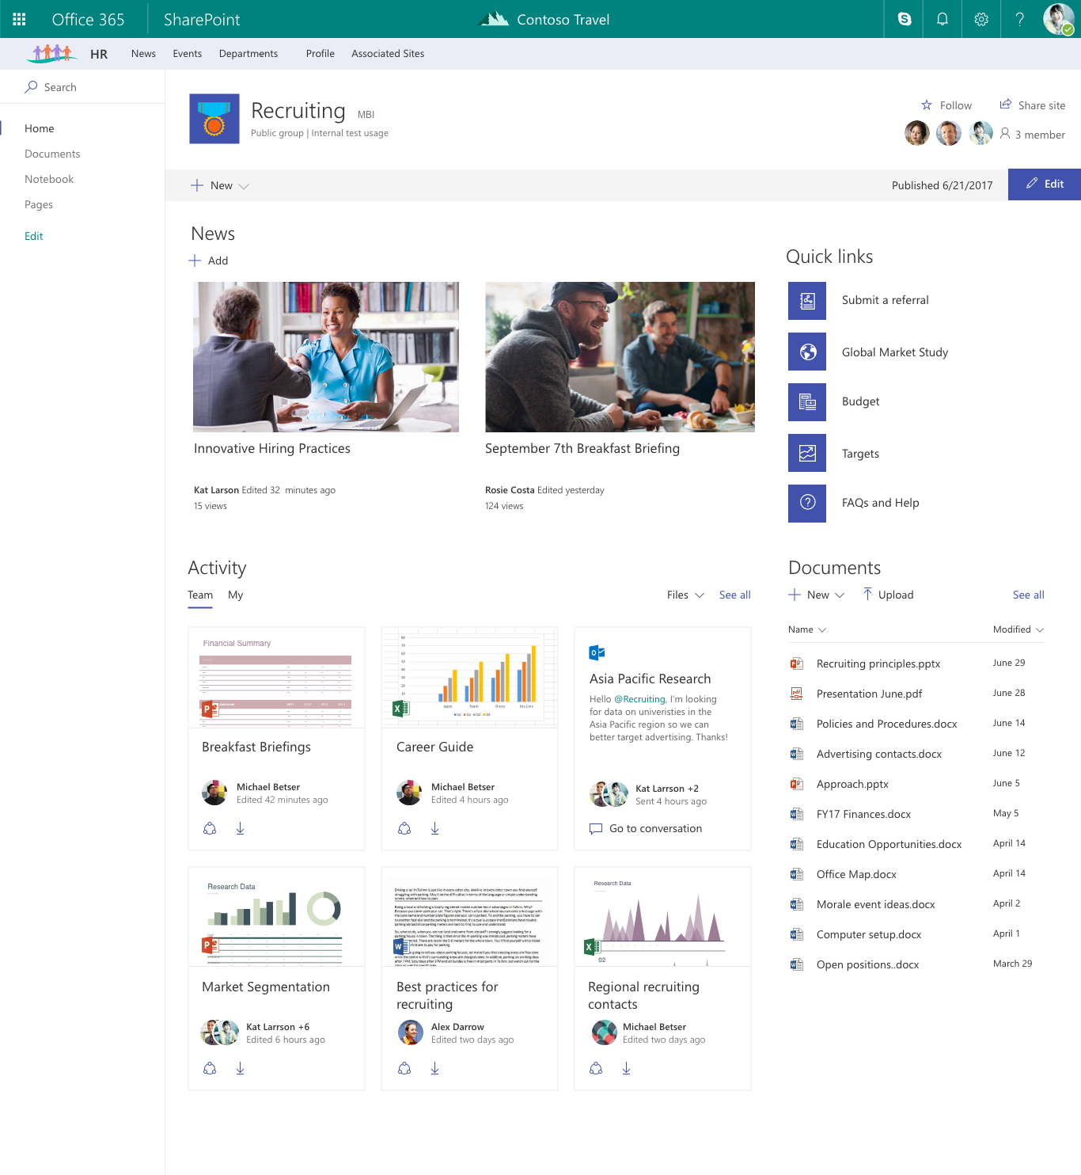

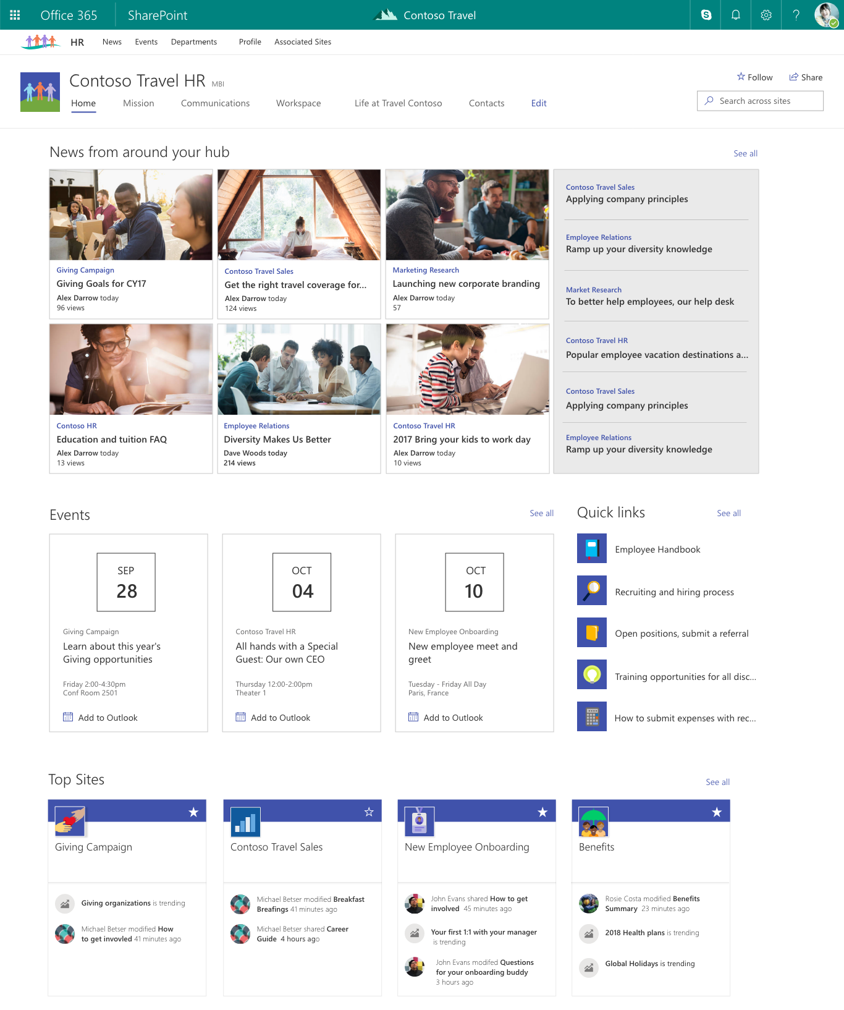
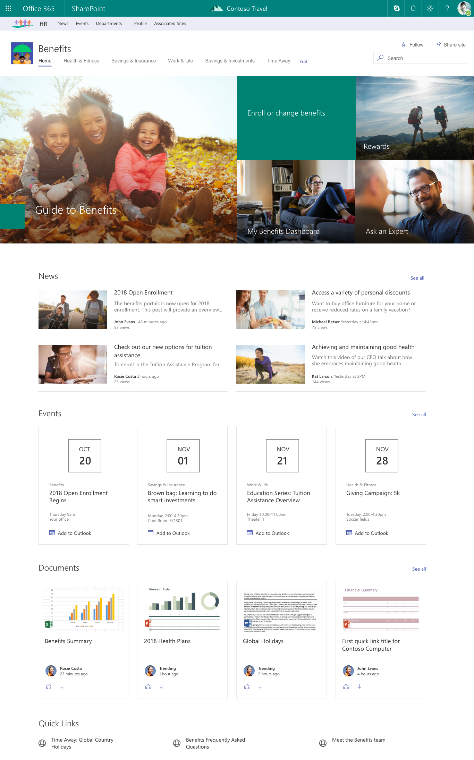
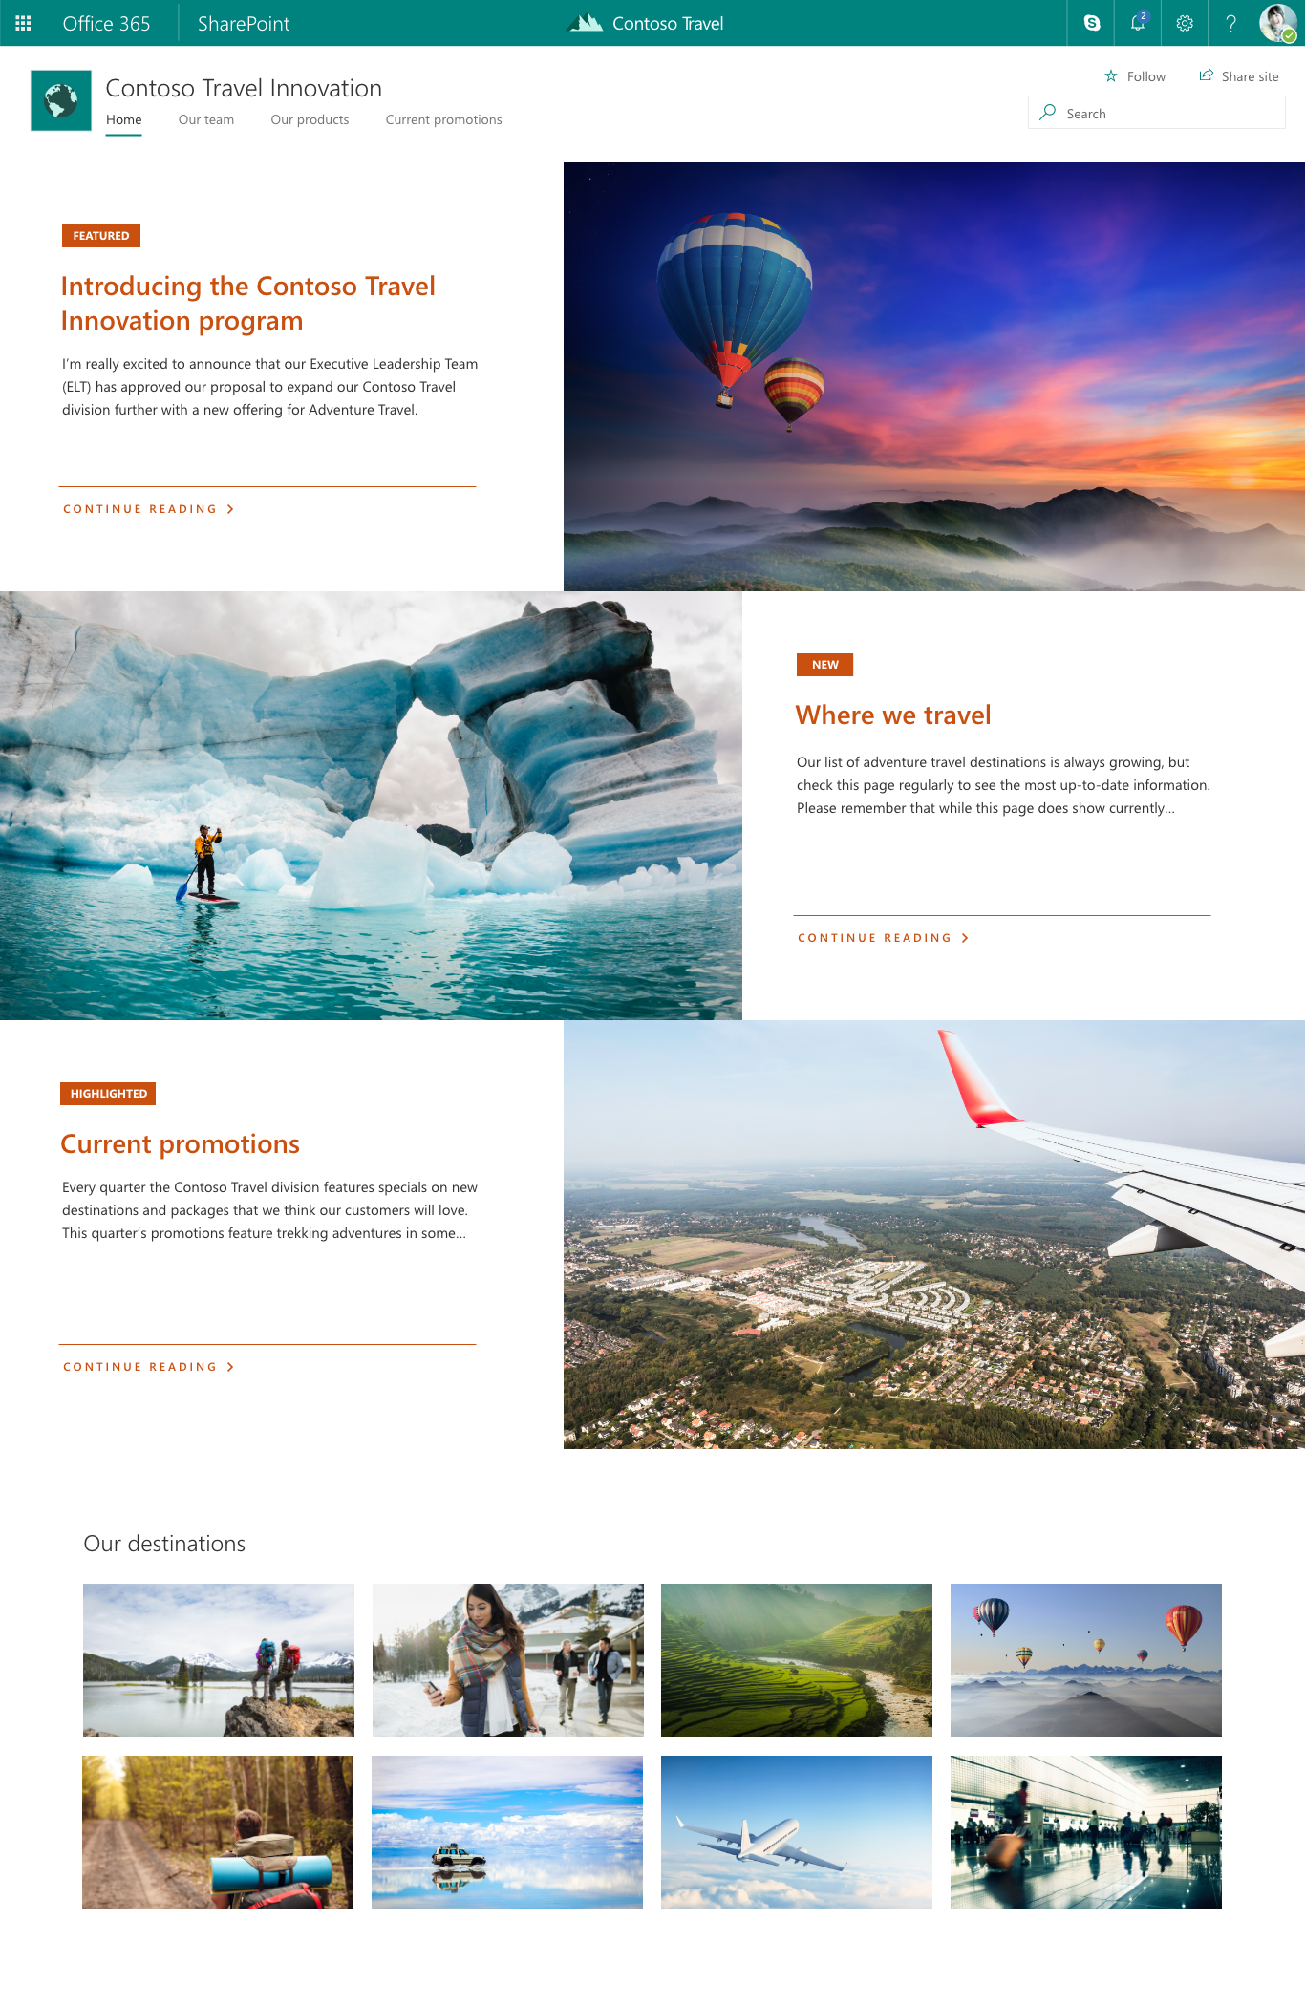
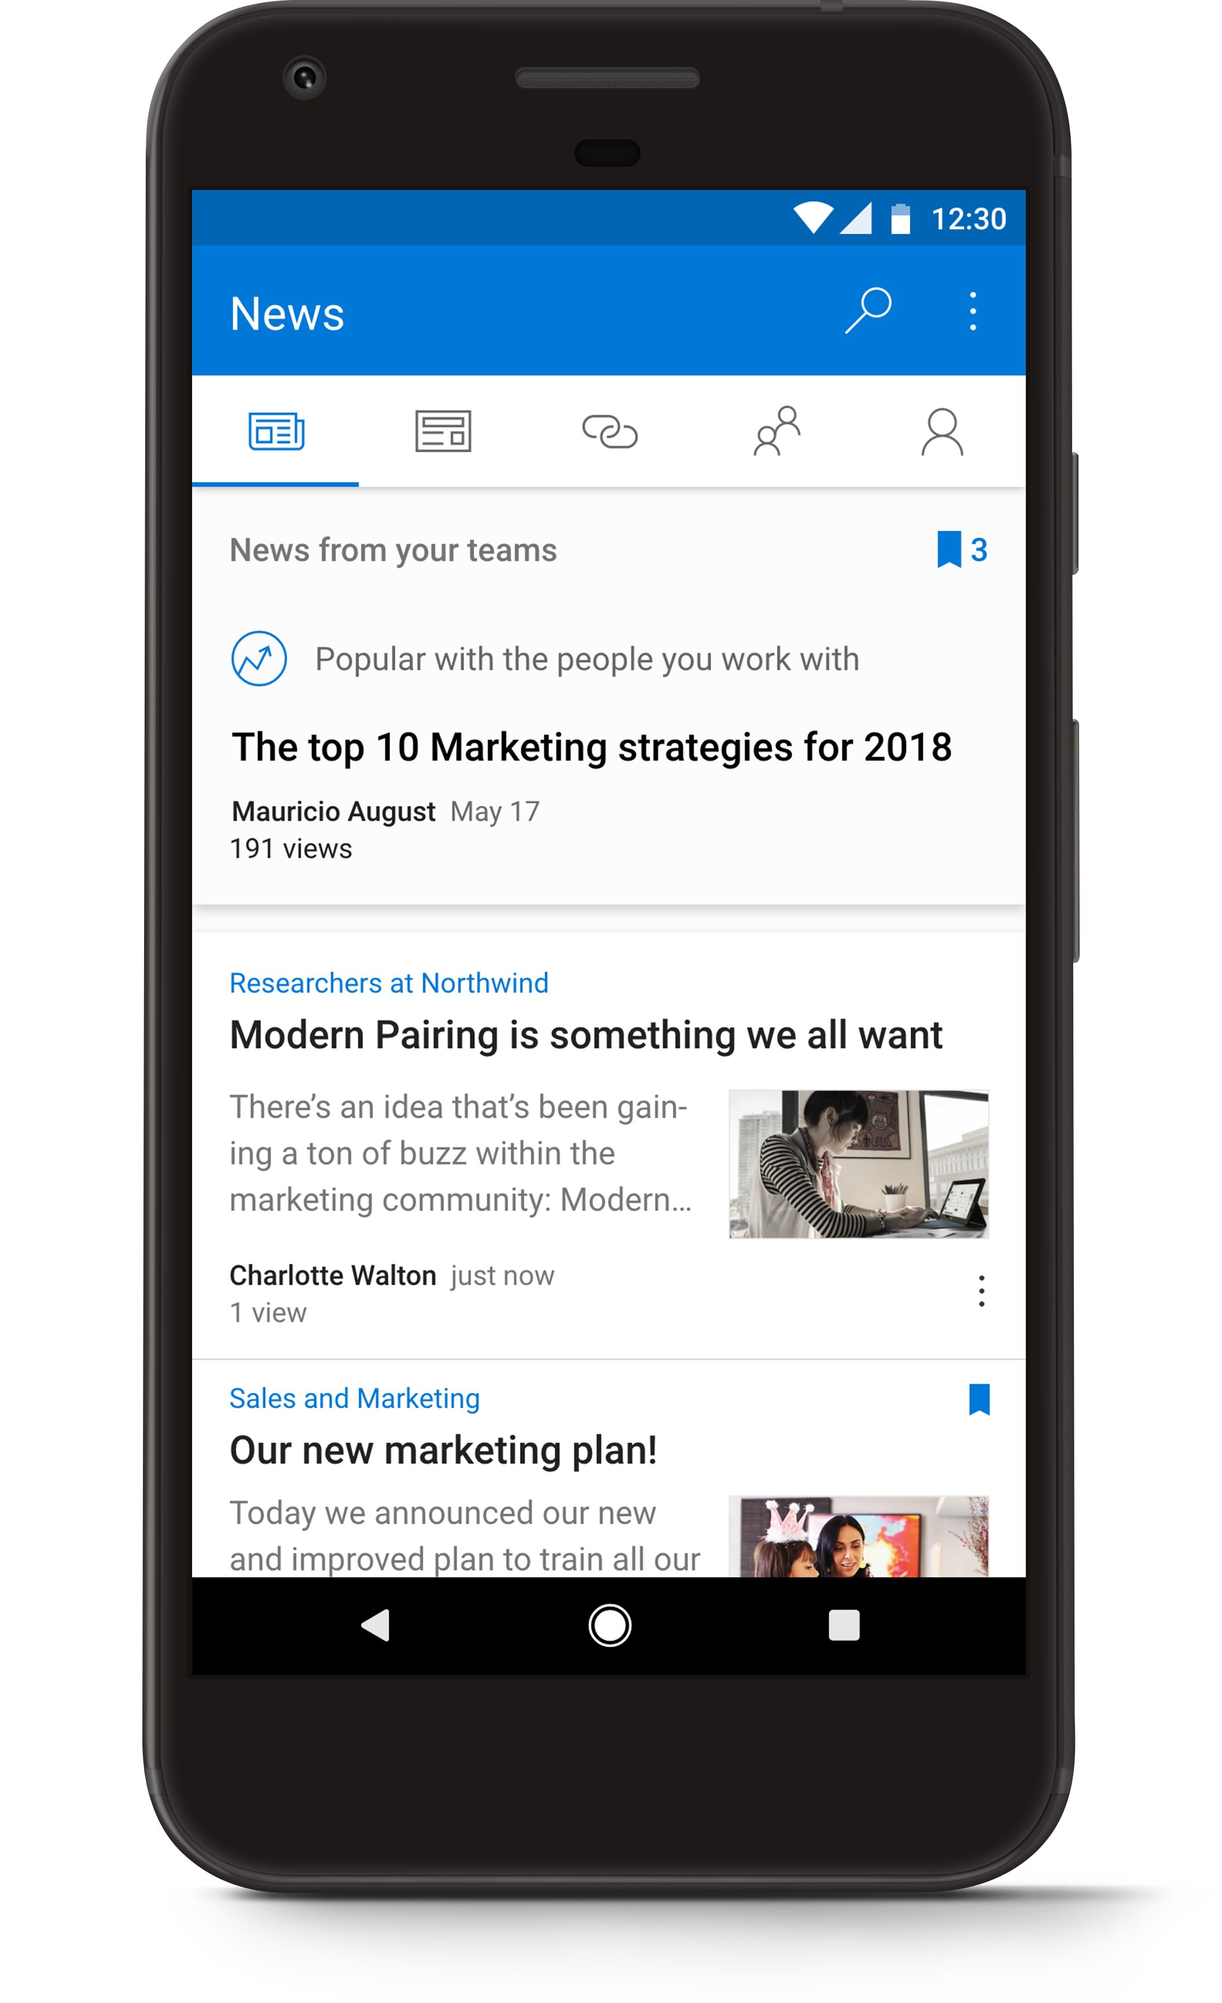
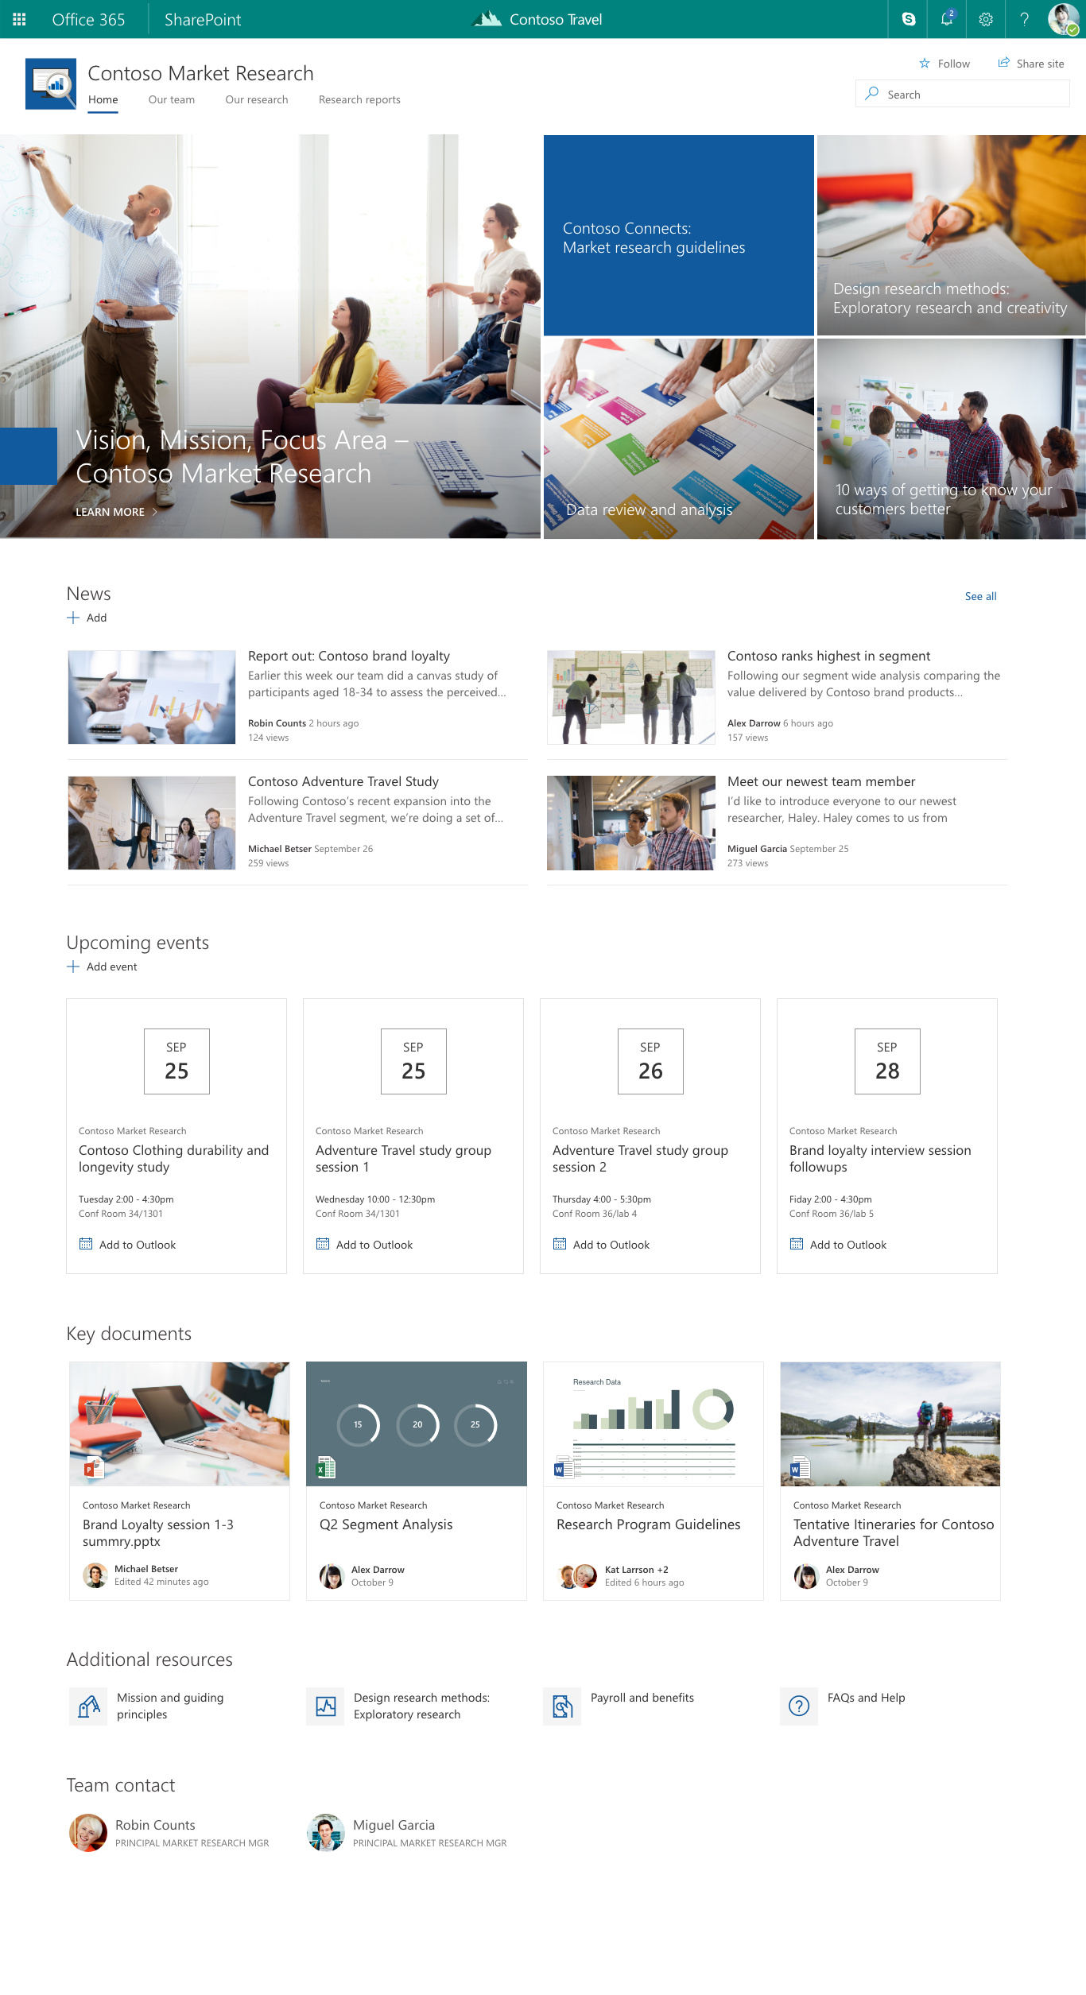
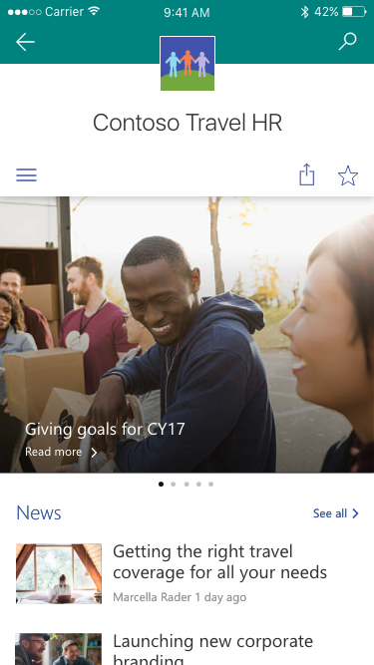
SharePoint Hub Sites – Quick Example
Team sites
Hub site
Communication sites
Benefits
today…

Slide 11



A dynamic, ever-changing digital workplace
Acquired sales
Travel innovation
Vendor agreements
Customer connections
Legal portal
Travel
Programs
Company-wide
Quarterly reports
Regional sales
Sales
Expense tracker
Cultural
Eco
Records center
Adventure
Benefits
planning
Big wins
Customer
Event planning
Benefits
Regional partner outreach
Recognition & rewards
New hires
EMEA
EMEA sales
Policies
key
HR
Hub site
Communication site
Team site
Partner solution
Custom portal

Slide 12
A dynamic, ever-changing digital workplace
Acquired sales
Travel innovation
Vendor agreements
Customer connections
Legal portal
Travel
Programs
Regional sales
Company-wide
Quarterly reports
Sales
Expense tracker
Cultural
Eco
EMEA sales
Records center
Adventure
Benefits
planning
Big wins
Customer
Event planning
Benefits
Regional partner outreach
New hires
EMEA
Recognition & rewards
Policies
key
HR
Hub site
Communication site
Team site
Partner solution
Custom portal

Slide 13
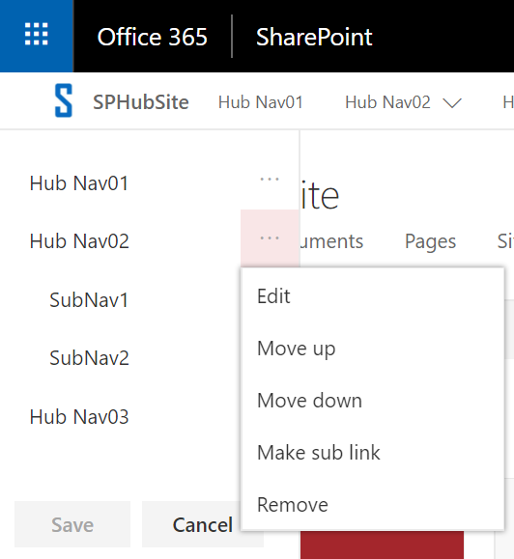
Global Navigation
Navigation configured in the Hub Site
The hub site navigation by default is static and you must have full control of the main hub site, and edit the navigation on that site.
Adding sites to the hub doesn't add them to the hub navigation
Associated sites inherit navigation from the Hub Site
Navigation is not security trimmed
If the user doesn’t have permission to the site, it will redirect to Access denied page.
We can build security trimmed navigation using SharePoint Framework (SPFx)
Can take time for the navigation to appear in the associated sites
Supports drop down items and Mobiles

Slide 14
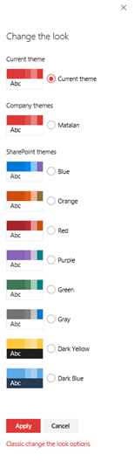
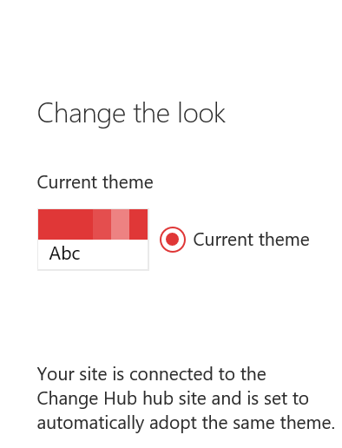
Logo and Site Theme
Associated sites inherit logo and site theme from the Hub Site
Across associated sites use the same logo, look and feel
We can’t change the associated sites theme. It always inherits from the hub sites
While disconnecting from one Hub and connecting to another hub, automatically updates the new Hub site theme
If you remove the association and select none, theme will not change automatically
When selecting a new theme, a customize option appears

Slide 15
News Rollup
All associated sites’ news rollup to Hub sites
News can be created on the Mobile App
There is a delay because it depends on Search crawling the content
Comments and likes appear in both the Hub and source site immediately
Current Limitations:
News cannot be scheduled
No approval process
Hub Sites
Sales
Finance
IT

Slide 16
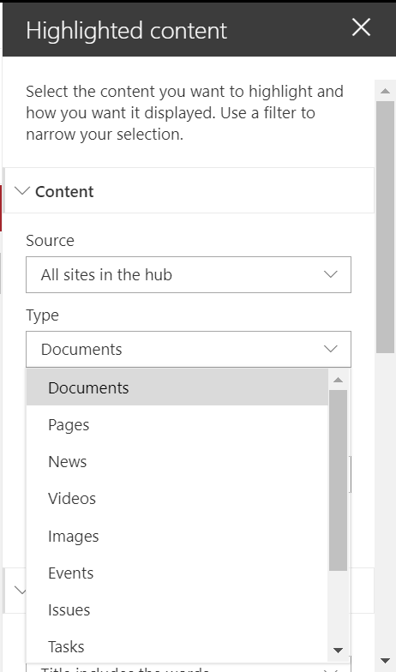
Highlighted Content Webpart
Content roll up from sites connected to the Hub site
Rollup content based on Content Type
Supports Filtering and Sorting
Rollup Documents, Lists, Pages, News, Videos, Events, Issues,
Tasks and Links
Links to recent activities

Slide 17
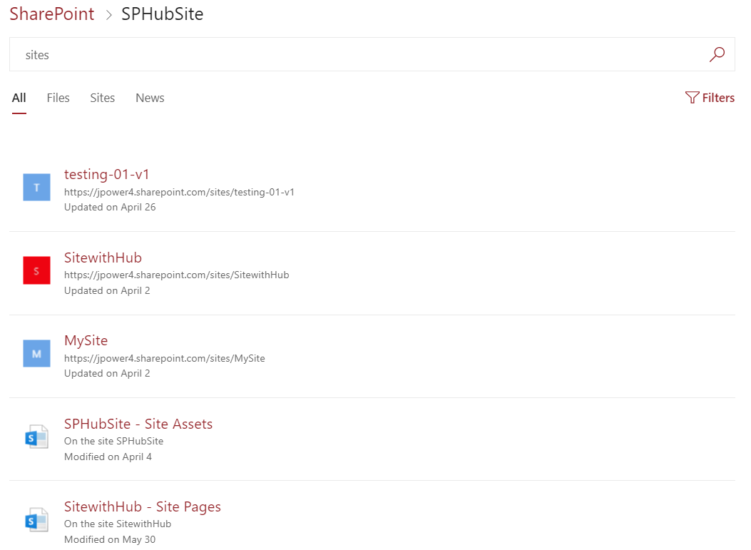
Search
Search scoped to connected Hub sites
Security trimmed
New default result sources:
All
Sites
Files
News

Slide 18
Security
Associated sites cannot inherit security from the Hub Site
Security should be configured individually per site collection
Permissions must be configured on connected sites individually
Use groups to apply permission across Site Collections
Content rollup, News and search is security trimmed

Slide 19
Demo – Creating a Hub Site
Step 1: Create a Communication Site or Team Site
Step 2: Register the site as a Hub Site
To Register Hub Site we need admin permission, only administrator can register the site as Hub site using PowerShell
Use SharePoint Online PowerShell Console, download the Latest version.
To Connect the admin site
PS C:\Windows\system32> connect-SPOService -Url https://tenant-admin.sharepoint.com
PS C:\Windows\system32> Register-SPOHubSite –Site https://tenant.sharepoint.com/sites/hubsitename
To grant permission while registering hubsites
Register-SPOHubSite -Site https://tenant.sharepoint.com/sites/hubsitename -Principals ‘user@domain.com’

Slide 20
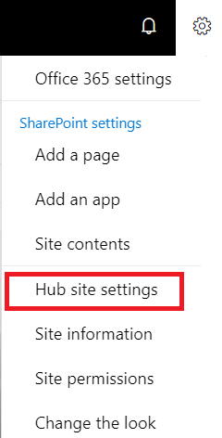
Demo – Hub site settings
Click the Cog and then choose ‘Hub site settings’ to change the logo
Click the cog and then ‘Change the look’ and select the Theme and customize it.
Add the Global Navigation

Slide 21
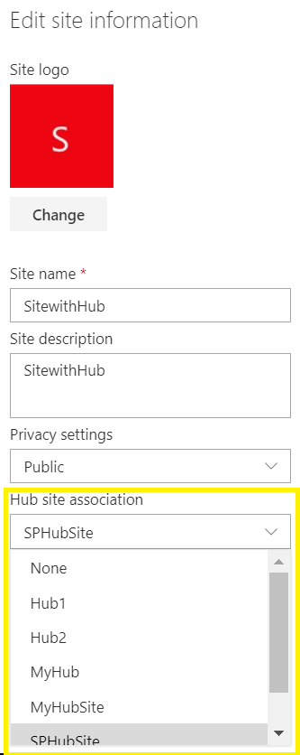
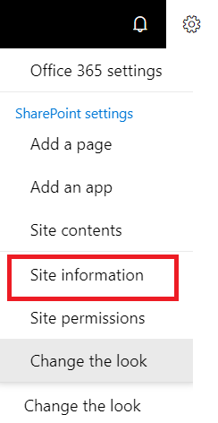
Demo – Associate sites with Hub sites
Step 1: Create a Communication or Team Site
Step 2: Click the cog and the select ‘Site information’
Step 3: Select the Hub Site to associate with.
Using Powershell
Step 1: Connect the Admin site
PS C:\Windows\system32> connect-SPOService -Url
https://tenant-admin.sharepoint.com
Step 2: Associate the site with Hub
PS C:\Windows\system32> Add-SPOHubSiteAssociation https://tenant.sharepoint.com/sites/projects -HubSite https://tenant.sharepoint.com/sites/hubsite

Slide 22
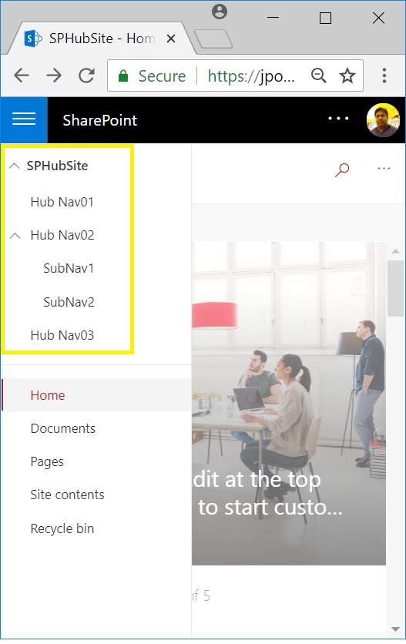
Mobile Support
SP Hub Site Navigation Supports responsive view
Good mobile support on iOS and Android

Slide 23
SharePoint Conference 2018 Updates
Hub site news web part update
The unique ‘hub layout’ in the news web part for SharePoint hub sites will provide additional capabilities like pinning news articles, a new compact layout, and carousel support.
Add rich colors to the hub site header
You will now have choices beyond the color white. It’ll be easier and more flexible to adhere to your preferred company theme and brand colors across more aspects of the sites and pages.
Approvals for hub site association
A flexible approval process further empowers hub site owners and site owners to make requests and programmatically adapt to changes within their growing, dynamic intranet.
Site scripting during hub site association
Once a site gets associated to a hub site, it not only inherits the theme of the hub site, it can now be further configured using powerful site scripting methods to enforce permissions, shared metadata, preferred content management, brand elements and policies.

Slide 24
FAQs
How many Hub sites can a tenant have? 50
Can I connect one Hub site to another? No
Can a site associate to more than one Hub site? No
Can I disconnect from one Hub and join another? Yes
Can I connect a classic SharePoint site to a Hub? No
Can I convert existing Sites to Hub Sites? Yes
Can I create a Classic SharePoint Site as Hub Site? Yes with Limitations (News and content rollup will not support)
Any limit to associate the hub site? No

Slide 25
Summary
Hub sites complete a big part of the Modern SharePoint Architecture Puzzle
Navigation, theme and logo are inherited by connected sites
Combined News Webpart in Hub
Content roll up from sites connected to the Hub site
Search is scoped with the Hub and connected sites
Good mobile support on iOS and Android

Slide 26
QUESTIONS & ANSWERS

Slide 27
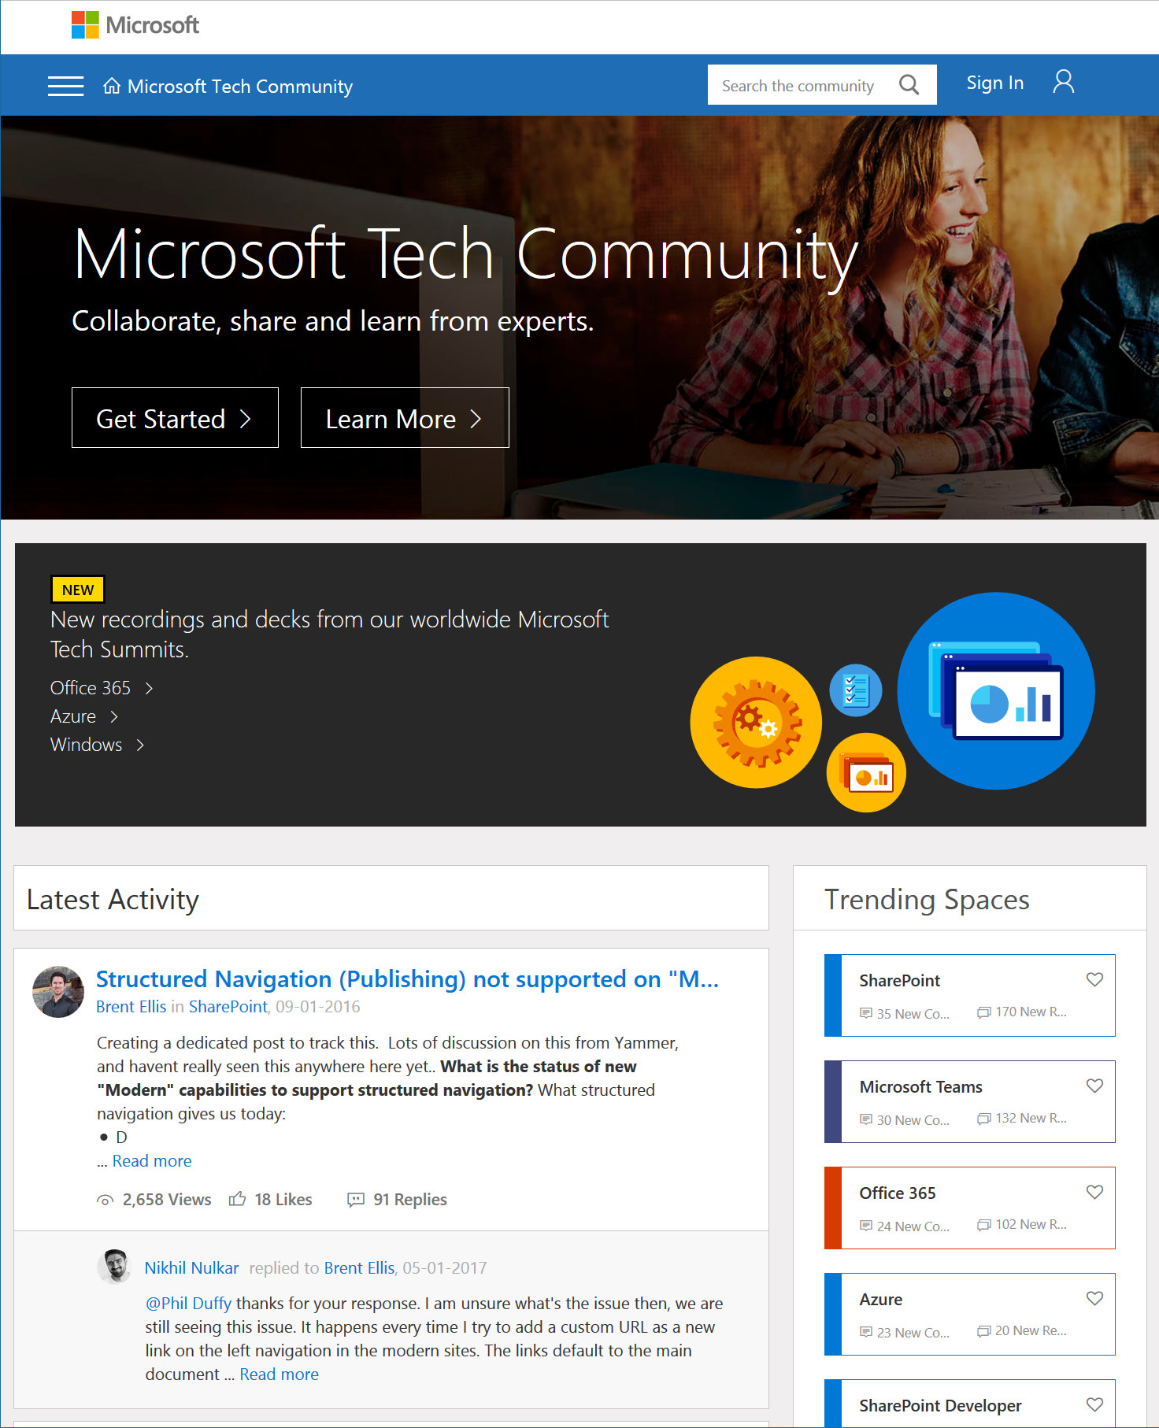
Microsoft Tech Community
techcommunity.microsoft.com
One Microsoft community for IT Pros and tech enthusiasts to learn from experts on Microsoft products
Trusted resource for news, best practices and answers from Microsoft product teams and MVPs
Join today! It’s free – sign in with your Microsoft Account.

Slide 28
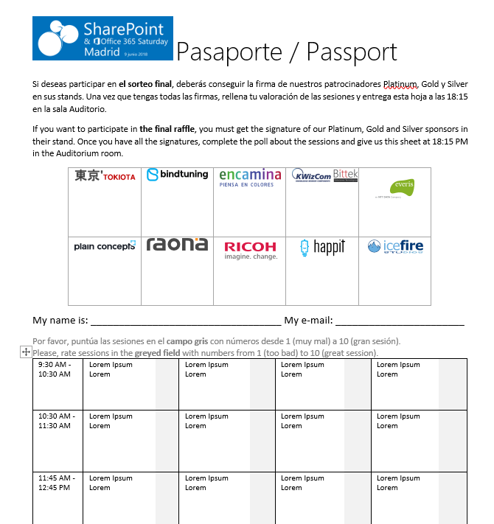




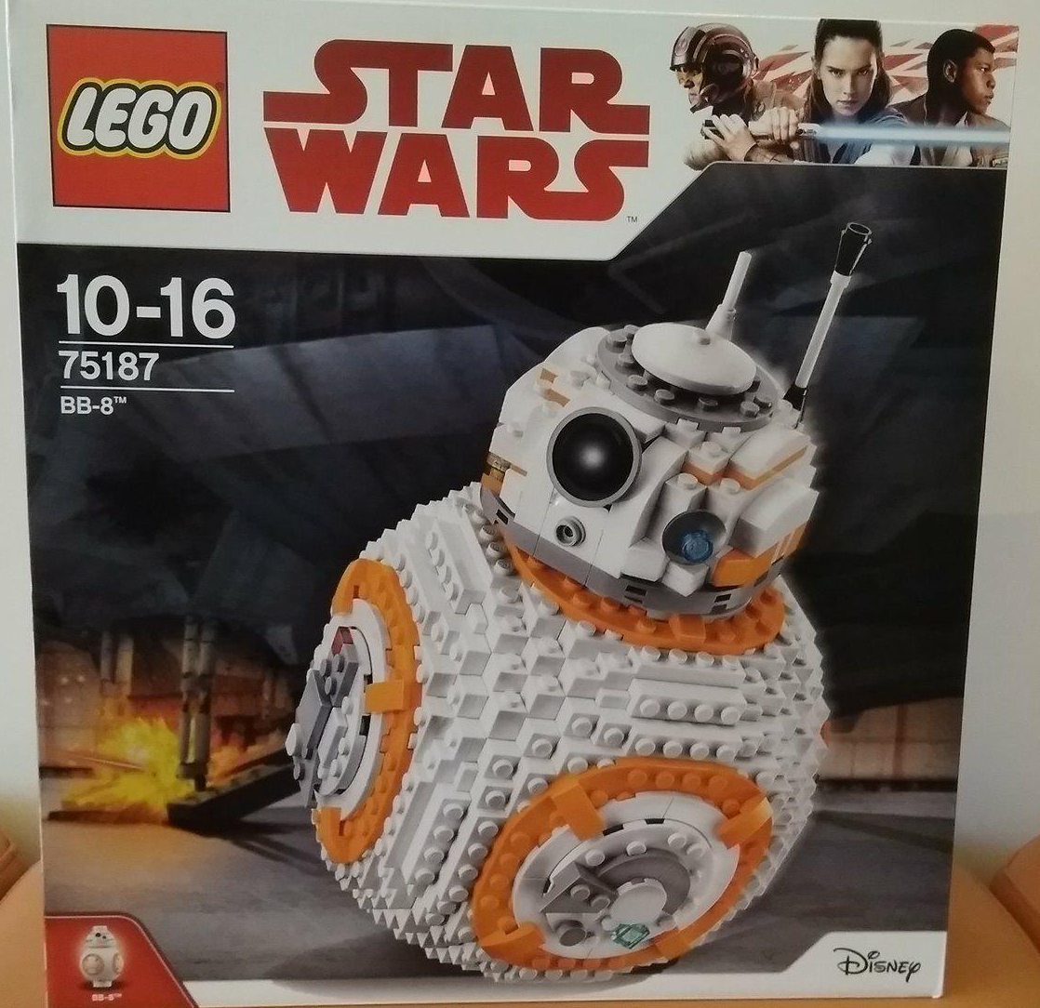


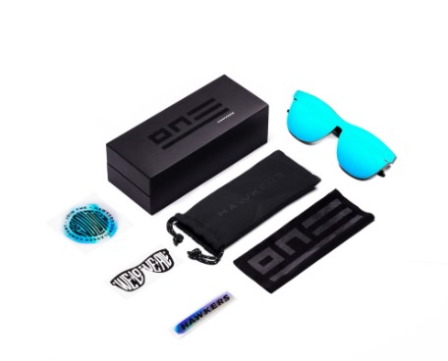








Raffle
Please, fill your SP & Office 365 Saturday Madrid passport if you want to participate.
You can win one of these gifts:
Please, fill your SP & Office 365 Saturday Madrid passport if you want to participate.
You can win one of these gifts:
Odor
Odor@winterfell.com
10
9
2x
2x
8

Slide 29
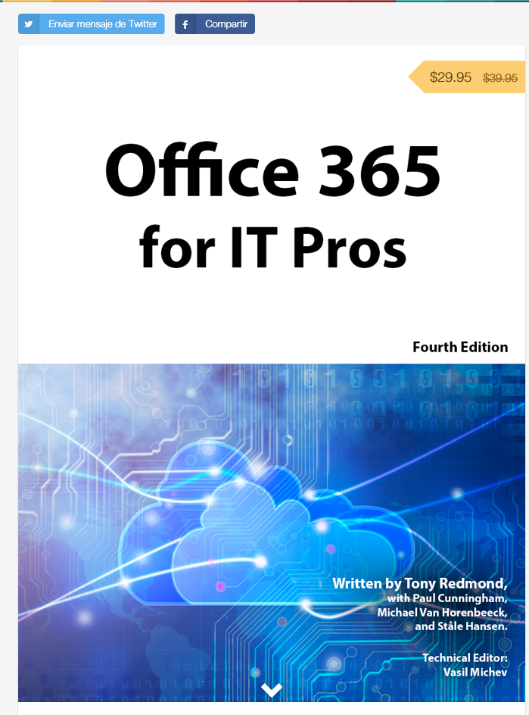
Office 365 for IT Pros
Get a discount of $10 buying the book here: https://gumroad.com/l/O365IT/spsspain

Slide 30
Notes:
This slide is mandatory. Please do not remove and try to use it during Q&A at the end of your session. Thank you!

Slide 31
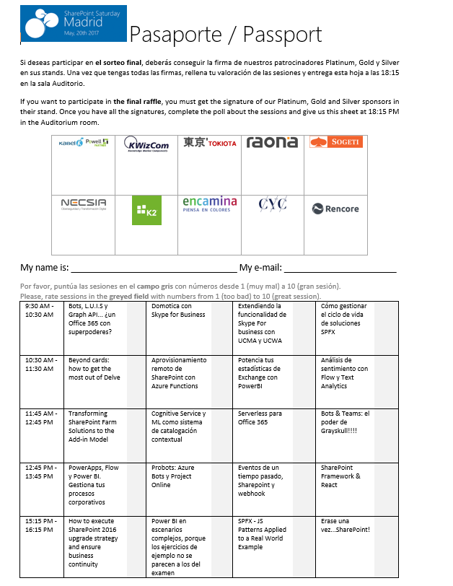
Raffle
Please, fill your SP & Office 365 Saturday Madrid passport if you want to participate.
You can win one of these gifts:
Odor
Odor@winterfell.com
10
9
8

